Slide 1
Hotel Booking Cancellations
SC1015 Mini Project
FCS5 Group 7
Ponmurugu Thanga Tharun
Risha Sunil Shetty
Tristan Amadeus Surya
Notes:
Good morning, this is the data science and artificial intelligence, we are group 7 from FCS5, today we will be presenting on Hotel Booking Cancellations.

Slide 2
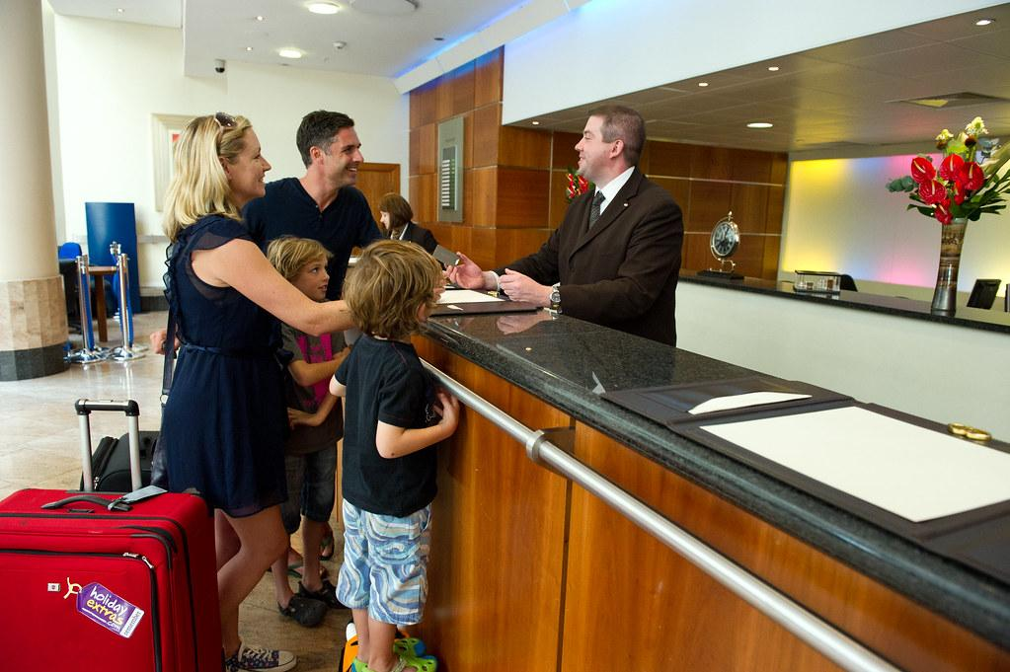


Notes:
In our digitally driven era, the process of hotel booking has undergone a significant transformation, with the widespread adoption of online booking platforms. These platforms have undoubtedly enhanced accessibility and streamlined the booking process, However, this digitalization has also facilitated an easier process for hotel booking cancellations

Slide 3

Free Cancellation Policies
Notes:
Particularly with platforms such as Booking.com, which promote free cancellation policies.

Slide 4
Booking.com
Hotel’s Website
VS
50 %
Cancellation Rate in 2018
18.2 % Cancellation Rate in 2018
Notes:
Statistics from 2018 indicate that online platforms, Booking.com in this case experienced a staggering 50% cancellation rate, whereas direct bookings through hotel websites had a considerably lower rate of cancellation of 18.2%. This disparity underscores the significant impact of online booking platforms, especially those that promote free cancellations, on cancellation rates.

Slide 5
Impacts
Loss of revenue
Hinders hotel’s marketing efforts
Decline in hotel ranking
Necessitates additional effort and resources from hotel staff
Notes:
Cancellation of hotel bookings impacts hotels on various levels.
Cancellation equates to a vacant room is a loss-making entity. Even if the room is eventually resold, it would likely be at a lower rate, further exacerbating the revenue impact of cancellations.
Additionally, High cancellation rates also affect a hotel's marketing efforts, as Online Travel Agencies (OTAs) monitor and factor in cancellation rates when ranking hotels. In other words, frequent cancellations may lead to a decline in a hotel's ranking which may negatively impact the hotel’s visibility and appeal to potential guests.
Furthermore, last-minute cancellations and no-shows lead to extra work and stress for the hotel staff, particularly during peak periods.

Slide 6
Machine Learning
Notes:
Therefore, our goal is to leverage on machine learning to help hotels predict which hotel booking would likely be cancelled so that they may effectively plan out a solution to minimise losses in all possible affected aspects.

Slide 7
Dataset
INNHotelsGroup
36275 entries & 19 Columns
No duplicates or missing values
Notes:
For this problem, we have used the INNHotelsGroup data set from Portugal which has 36275 entries and 19 columns. The data set does not have any duplicates or missing values.

Slide 8
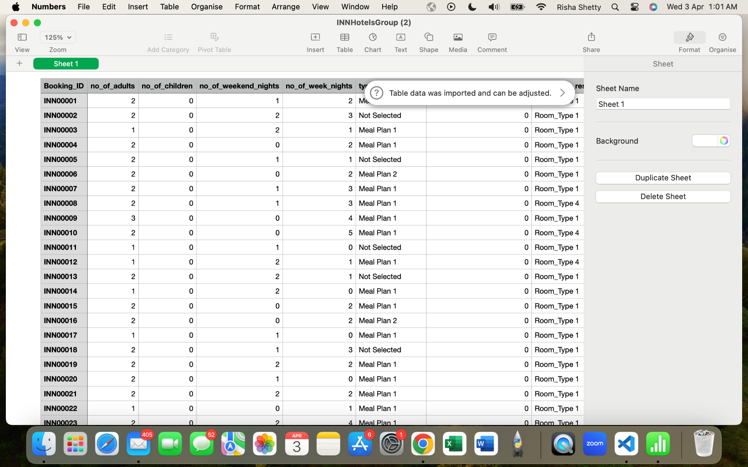
Data Preparation: Cleaning
We dropped the irrelevant column (Booking_ID)
This column will not be useful in helping us predict the likelihood of hotel booking cancellations
Notes:
Now, before moving on to the Exploratory Data Analysis, to simplify the data set, we dropped the irrelevant column (Booking_ID) as it is a unique values column that will not value add our research in any manner.

Slide 9
Exploratory
Data Analysis
Notes:
Moving on to Exploratory Data Analysis.
https://www.hotelmanagement.net/tech/study-cancelation-rate-at-40-as-otas-push-free-change-policy
https://www.hotelminder.com/everything-you-need-to-know-about-hotel-cancellations

Slide 10
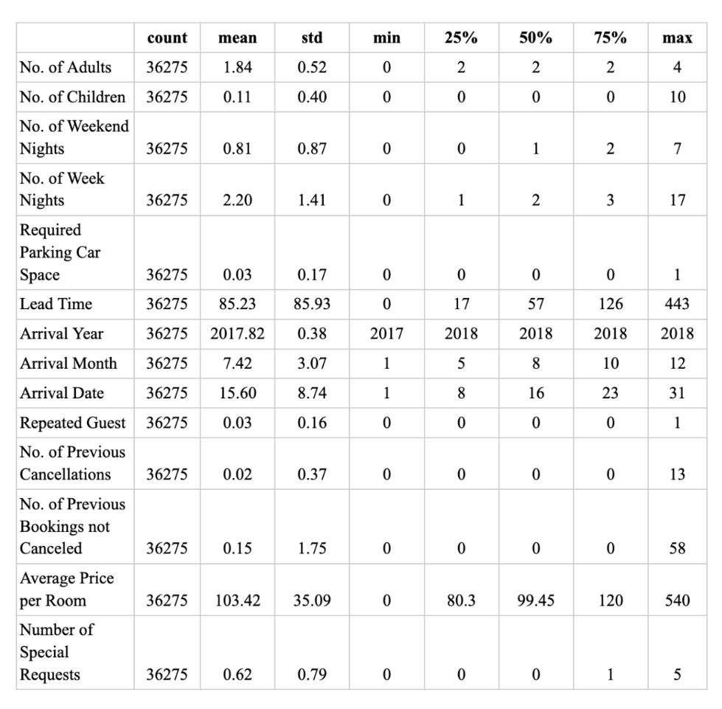
Notes:
After the removal of the Booking_ID column, there are a total 18 feature columns.

Slide 11
Univariate Analysis
Lead Time → No. of days between when a guest makes a reservation and check-in date.
Average price per room
Booking Status → Cancelled or Not Cancelled
Notes:
Out of the 18 features, we performed univariate analysis on couple of features however we will mainly be discussing Lead Time, Average price per room and Booking status.

Slide 12
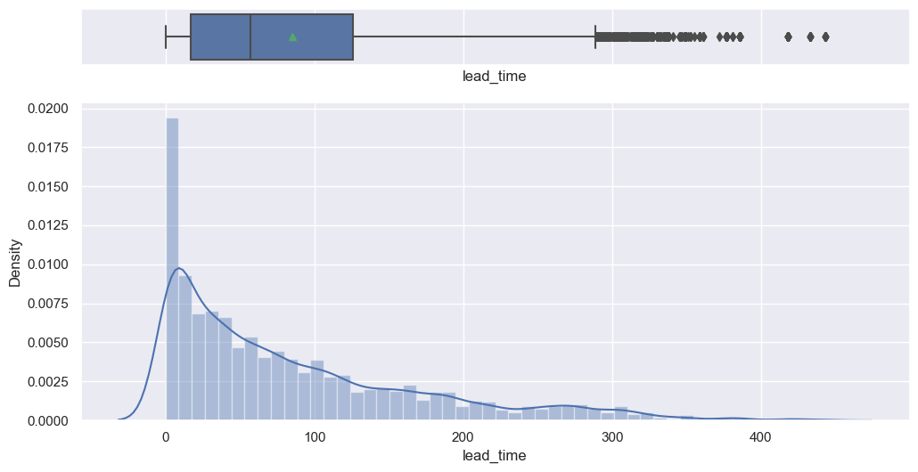
Lead Time
Outliers
Right- Skewed
Notes:
Firstly, we examined the lead time distribution using both a histogram and a boxplot. The histogram revealed a right-skewed distribution. The majority of the lead times was under 126 days which is understandable as it's common for individuals to plan vacations approximately 3 to 6 months in advance. The boxplot highlighted the presence of numerous outliers. However, these outliers may be attributed to factors such as special deals or promotions offered by hotels, prompting individuals to book well in advance.

Slide 13
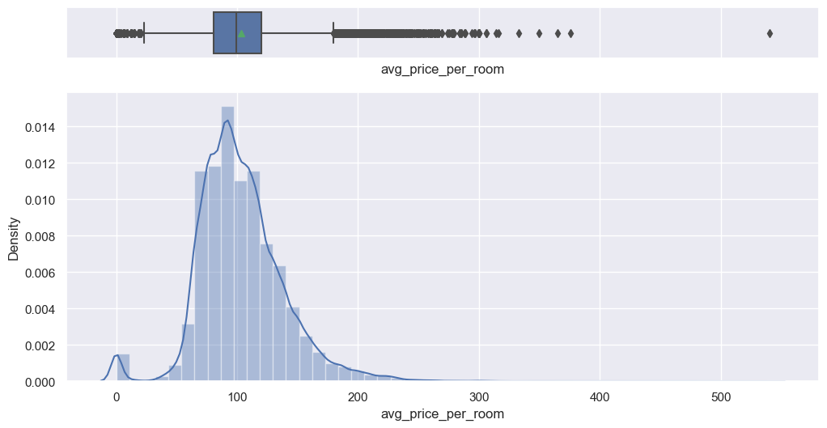
2. Average price per room
ZERO ?
Notes:
Similarly for average price, we utilised the same visualisation tools. Based on this data set, the average price per room ranged from 0 dollars to 375 dollars. This variation is expected considering the diverse range of room types available in hotels, spanning from standard rooms to suites.. However, we noticed a peculiar trend in the dataset and that was the presence of rooms priced at 0 dollars. We found that those were rooms provided as complimentary services by the hotel. Perhaps as part of a promotional deal or loyalty programs for members.

Slide 14
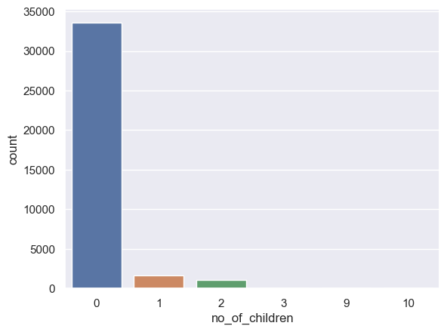
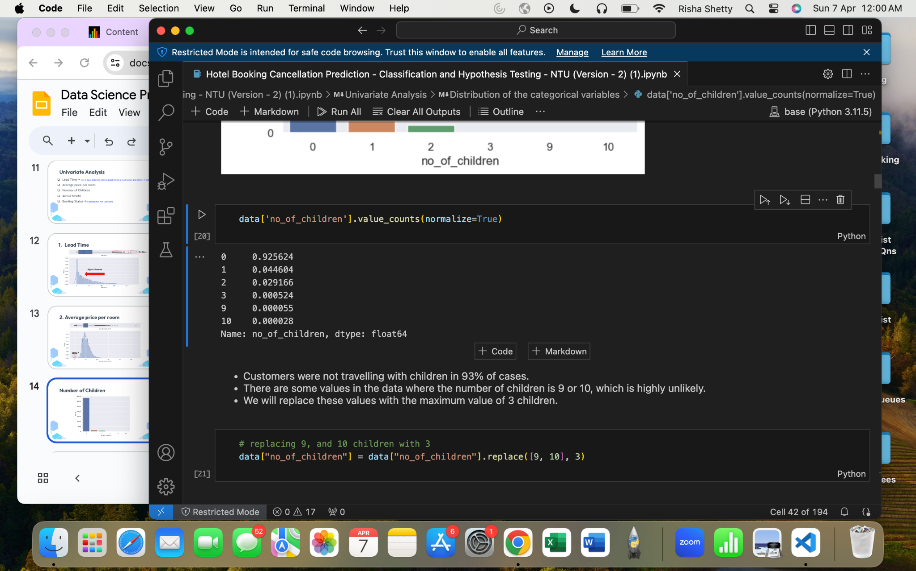
3. Number of Children
Notes:
Next, using the count plot, we found that 93% of customers did not travel with children. We noticed that there were a small percentage of customers with 9 or 10 children. Given the unlikeliness of 9 or 10 children, we replaced those data points with 3 children.

Slide 15
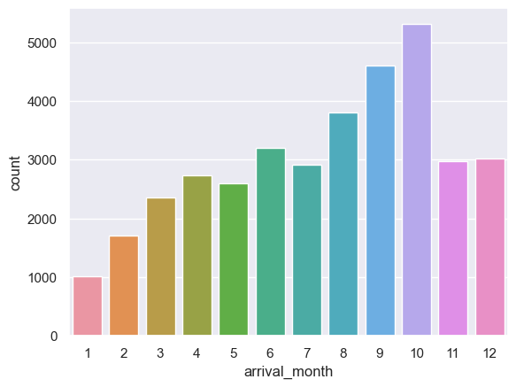
4. Arrival Month
October
Notes:
Next, similarly, using a count plot, we found that October is the busiest month for hotel arrivals followed by september and august. Over 35% of the bookings were for one of these 3 months. 14.7% of the bookings were for October specifically. This is expected as it was found that October is the best time to travel as the weather all around the world is generally favourable.

Slide 16
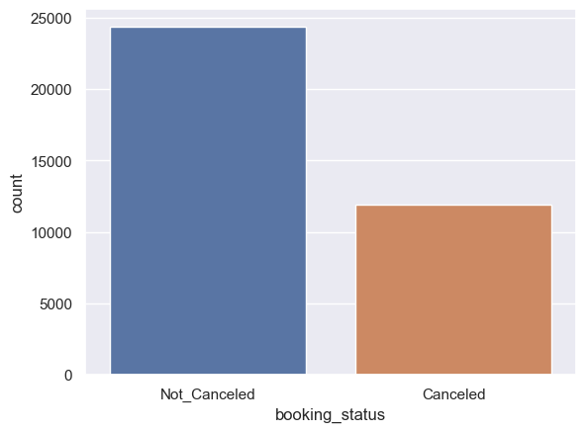
5. Booking Status
Notes:
Lastly, using a count plot, we found that 32.8% of the bookings were canceled by the customers. At this point, we are not able to definitively determine the reasons for cancellation, as there are normally multiple factors that influence a booking cancellation.

Slide 17
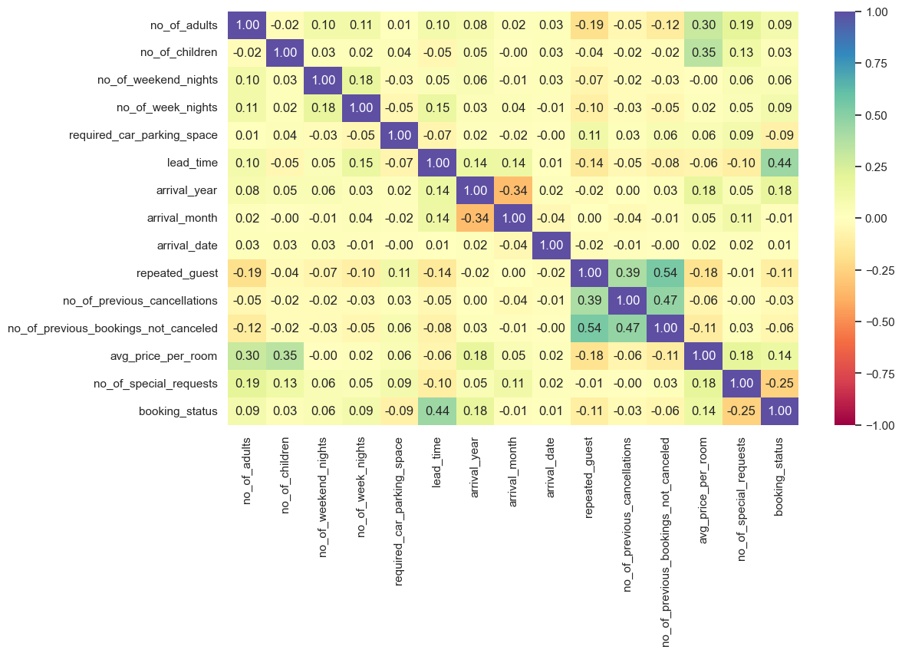
Bivariate Analysis
Repeated Guest
Lead Time
Notes:
So, to primitively get a sense of the factors that influence a cancellation, we performed bivariate analysis, starting from plotting a heat map for the numeric features. We found that repeated guests followed by lead time have the highest positive correlation with booking status of 0.54 and 0.44 respectively. Meanwhile the remaining features had weak correlations with booking status.

Slide 18
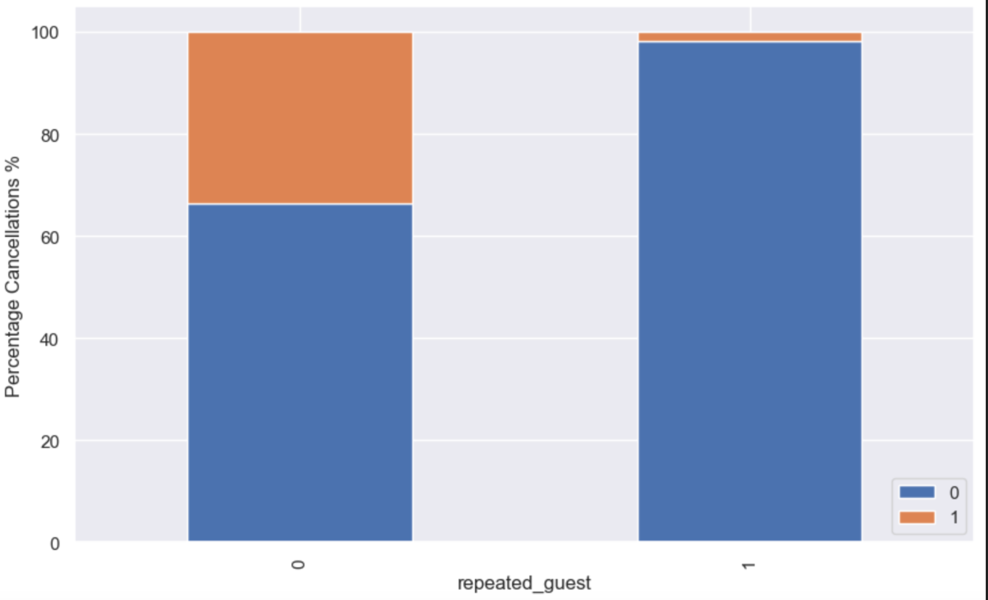
Repeated Guests vs Booking Status
X- Axis
1 - Repeated guest
0 - One time guest
1 - Cancelled
0 - Not-Cancelled
Notes:
Based on the heat map, repeated guests does have the highest positive correlation with booking status hence, we used a stacked bar plot to visually see the relationship between repeated guests and booking status. As seen, repeated guests have a very low cancellation rate compared to one-time guests. This may be due to the fact that repeated guests are likely to be loyalty members and are more likely to stay with the hotel due to their previous positive experience. Another factor may be that they are seasoned travellers, and are able to effectively plan their travel plans with minimal changes as compared to new travellers.

Slide 19
Notes:
Now other than what we had observed from the heat map.

Slide 20
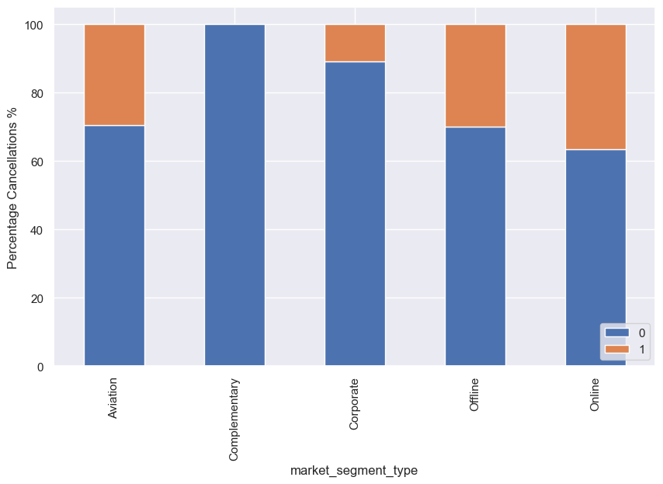
Market-Segment Type vs Booking Status
Complementary
Corporate
Aviation
Offline
Online
Notes:
Based on our domain knowledge, we were aware that market-segment type, in other words, whether booking is done online or offline or whether bookings are done by Aviation, they do play a role in influencing a booking cancellation. Hence, once again we used a stacked bar plot to explore the relationship between the market segment type and the booking status. As expected, bookings done online, have the highest number of cancellation. This maybe because of the ease of cancellation, impulse booking and comparison of prices with various booking platforms.
Now i’ll pass the time to Risha.

Slide 21
Data Preparation
Before Modelling
Notes:
After gaining a better understanding of our data set via the EDA, we further prepared our data set before modelling.

Slide 22
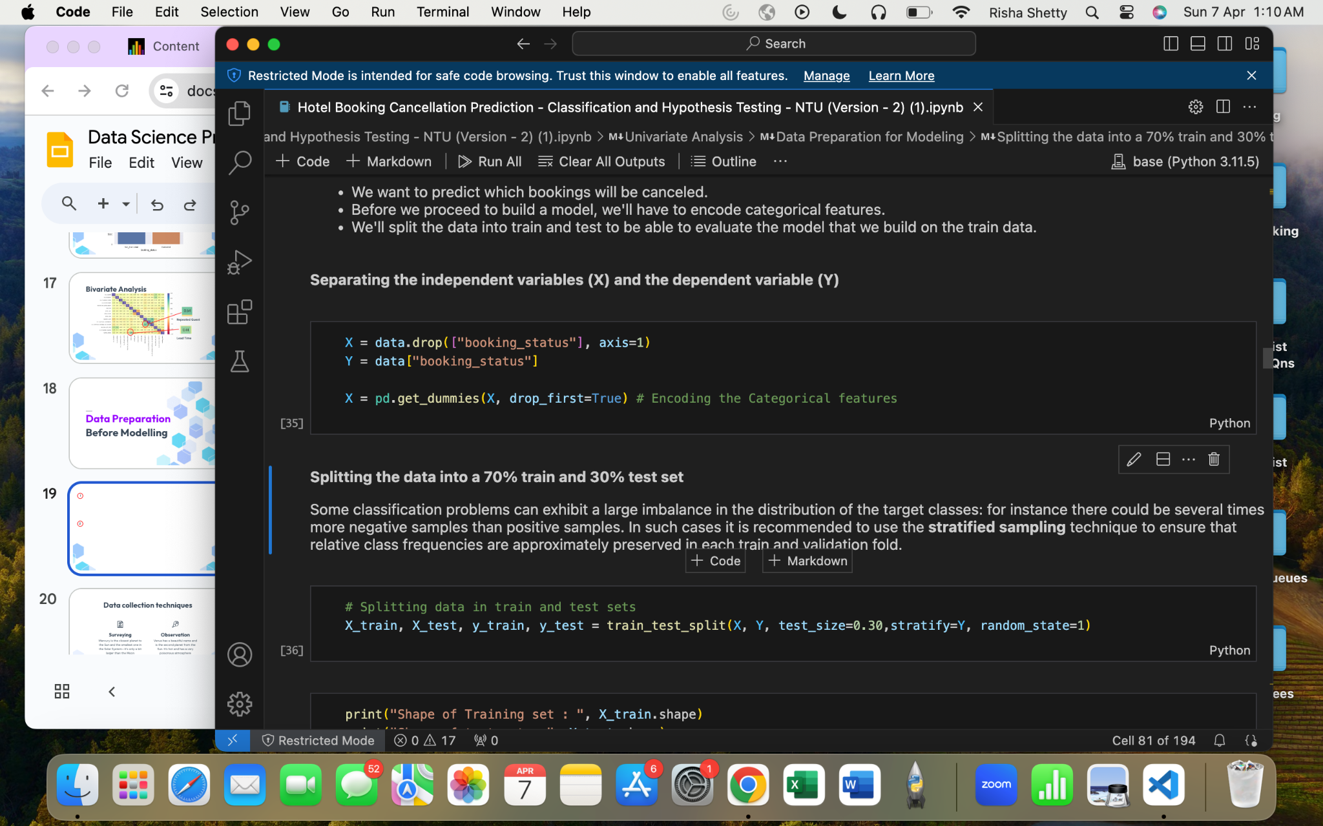
1
One-Hot Encoding
2
Train-Test Split
Notes:
We further prepped the data by splitting the predictors and the response variable and transformed the categorical variable, booking status to binary variable via One-Hot encoding as it is a more suitable format for training machine learning models. Next, we randomly separated the data set into 70 % training data and 30% test data.

Slide 23
Machine Learning
Notes:
Now to go about understanding which of the factors influence a cancellation and to predict the possibility of a cancellation. We decided to use 4 models.

Slide 24
Types of models utilised
Logistic Regression
Support Vector Machines (SVMs)
Commonly used to predict binary outcomes.
Performs well is High-dimensional spaces
Captures non-linear relationship between predictors and response variable
Decision Trees
Random Forest
Handle mixed data types
Capture non-linear relationship between predictors and response variable
High accuracy & Robust performance
Captures non-linear relationships between predictors and response variable
Notes:
The 4 models include, Logistic Regression, Support Vector Machines, Decision Tree and lastly Random Forest Model. Given the nature of our problem and the data set which is a binary classification problem with a wide large range of features, we utilised Logistic regression as it is a great model for a binary classification problem. We used SVMs as they are effective in high dimensional spaces. Next we used Decision trees as they are able to handle mixed data types making them suitable for various types of features found in hotel booking datasets. Lastly Random forests, encompasses the key features of all previously mentioned models.
We found that these 4 models would be best suited for our data set. For instance, Logistic Regression is commonly used when predicting binary outcomes, making it a suitable choice for analyzing factors contributing to hotel booking cancellation. Next, SVMs. Given the large number of predictors and the non-linear relationship between the predictors and the booking status, we found that SVMs could be another model we could test as it performs well in high-dimensional spaces and are effective in capturing nonlinear relationships between predictors and response variable. Next, decision trees. It is able to handle mixed data types without pre-processing and it is able to capture non-linear relationship between predictors and response hence we found it to be another possible suitable model to test. Lastly, Random forest model. It is known for its high accuracy and robust performance for binary classification, hence we found this to be another possible model to test as well.

Slide 25
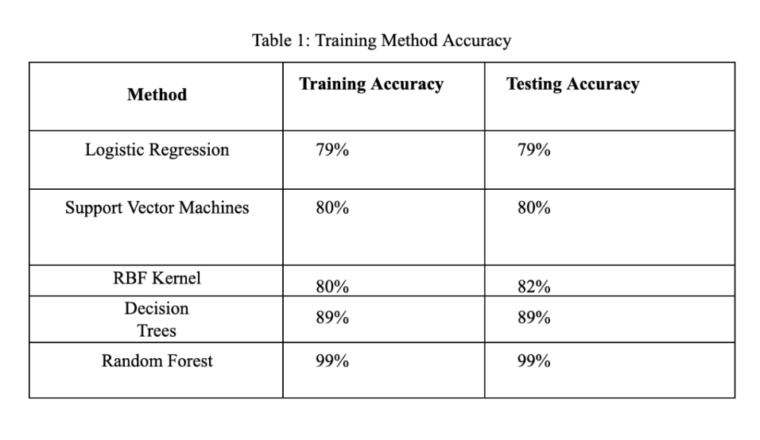
Accuracy of the models
Notes:
After implementing each of the models, we found that the Random forest model is the best model for predicting the likelihood of a cancellation followed by Decision trees which have a testing accuracy of 99% and 89% respectively.

Slide 26
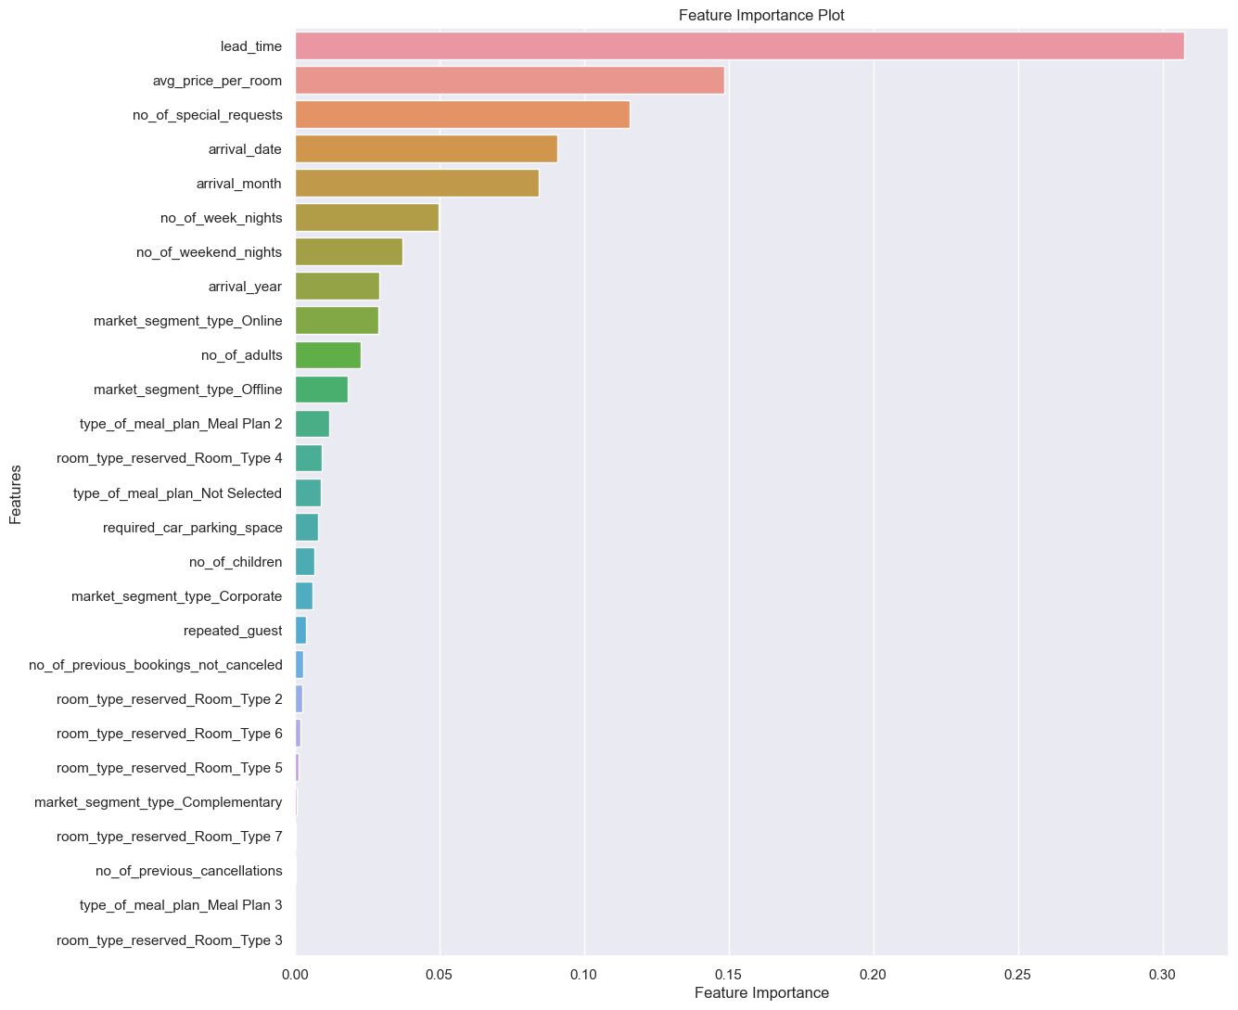
Feature Importance (RFM)
Collection
Cleaning
Exploratory
Despite being red, Mars is a cold place
Venus has extremely high temperatures
Neptune is the farthest planet from the Sun
Statistical
Visualization
Hypothesis
Mercury is the closest planet to the Sun
Saturn is a gas giant and has several rings
Jupiter is the biggest planet of them all
Random Forest
Notes:
Hence, given the high accuracy rates of the random forest model, we generated the feature importance to understand which were the top few features that influenced a hotel booking cancellation, based on this model and we found that lead time, average price per room and number of special requests were the top 3 features that affected the outcome of a hotel booking.

Slide 27
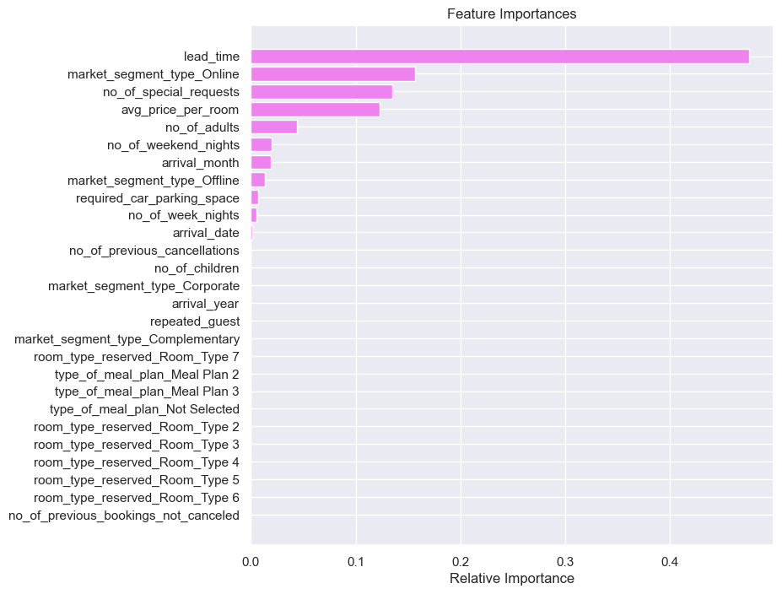
Feature importance (DT)
\
Notes:
Additionally, based on the decision tree which was the next most accurate model, we found that lead time, online booking, number of special requests and lastly average price of a room were the top few factors that contributed to a cancellation.

Slide 28
Class imbalance
Notes:
Based on our results, we identified few features that could help predict a cancellation however upon further analysis We had found a loophole, and that was the presence of the class imbalance seen in the booking status, which may potentially affect the accuracy of our results as there may be a possible bias towards the majority class which is the ‘Not cancelled’ class.

Slide 29
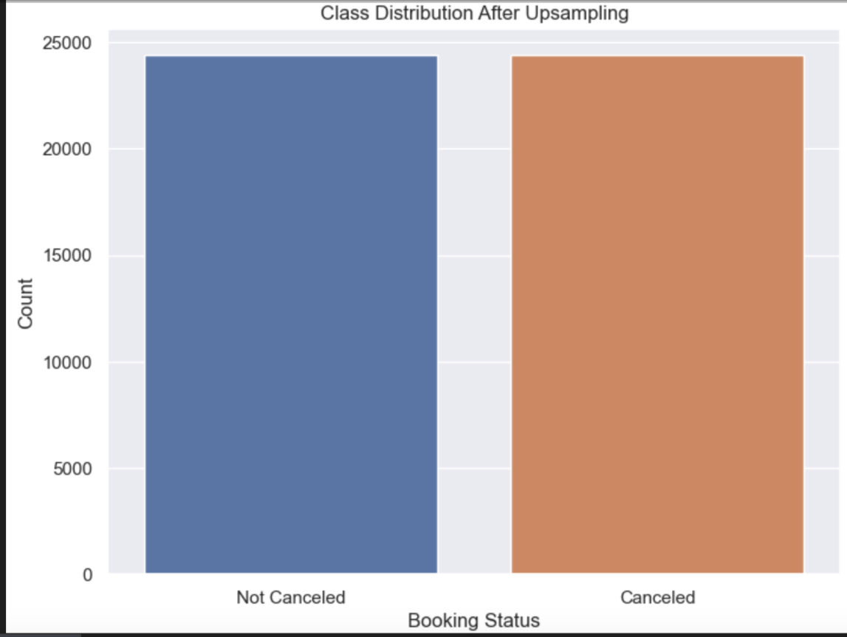
Upsampling
Notes:
Therefore, to address the class imbalance, we performed upsampling which involved increasing the number of instances of the minority class which the ‘cancelled’ class in order to balance the classes.

Slide 30
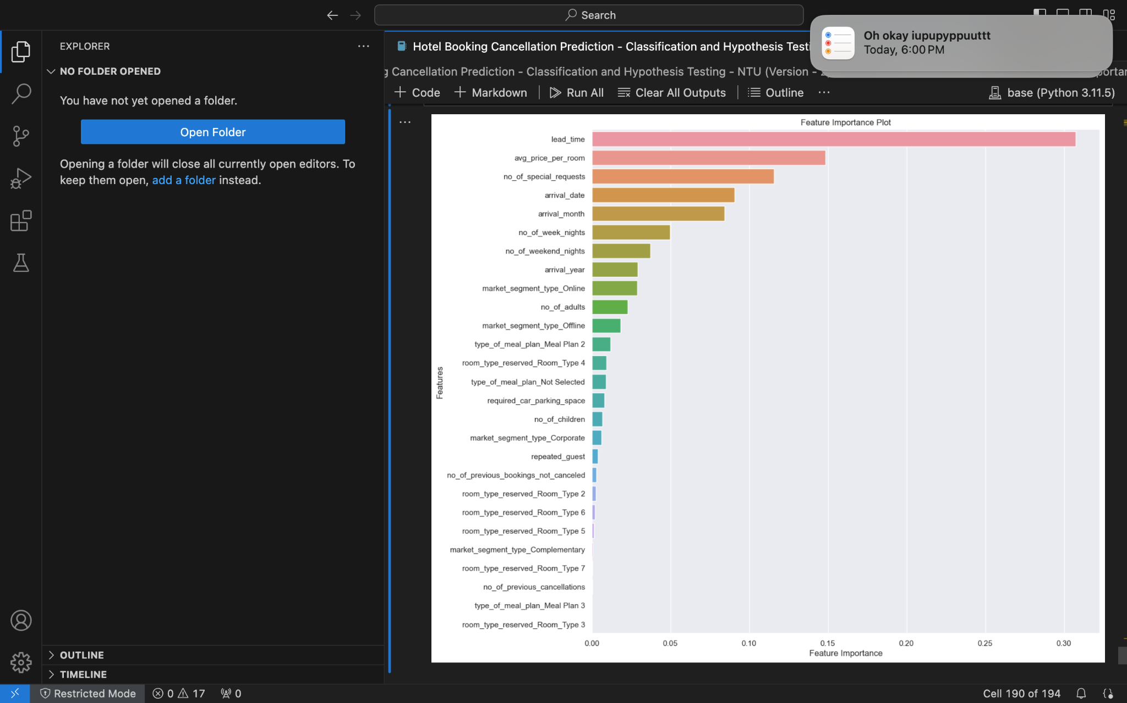
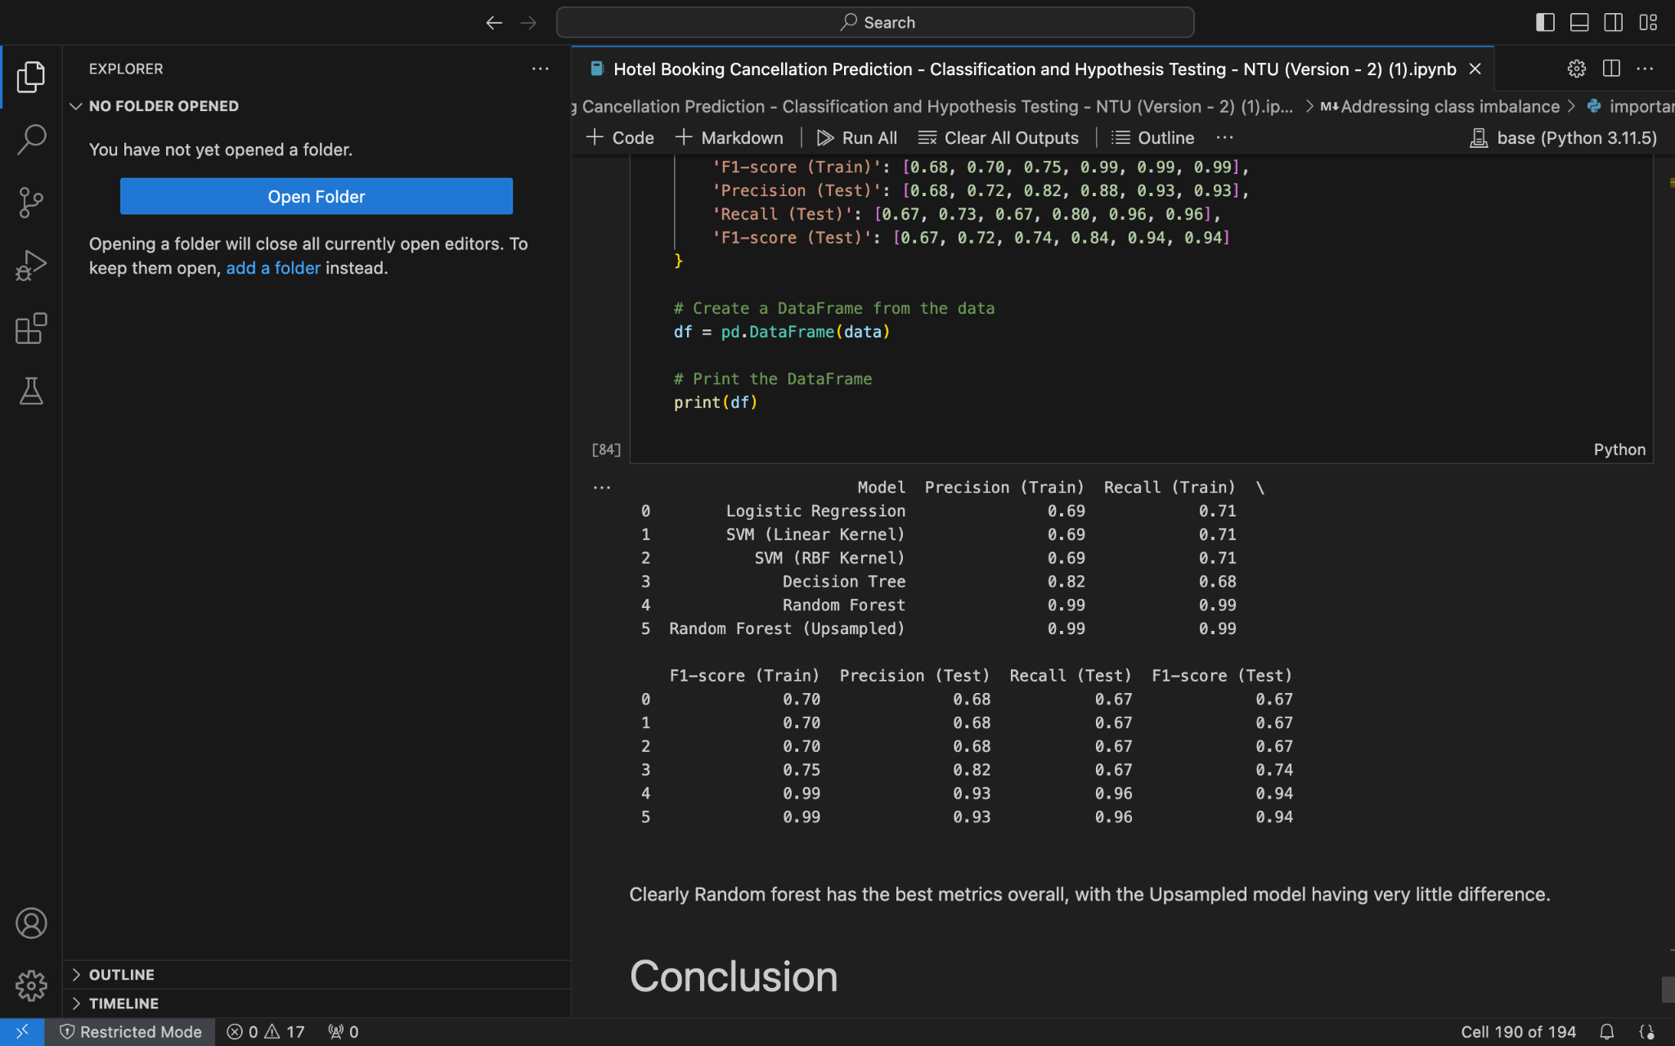
Modelling the modified dataset on RFM
Notes:
Given that the random forest model had previously had the highest accuracy, we decided to model this modified data set with the random forest model. The graph here shows the feature importance based on the newly modified and improved dataset. Based on the graph, as well as the table, not only does the random forest model have the best metrics but even with the upsampled data, there is little to no difference in the accuracy of the model.

Slide 31
Conclusion
Notes:
To conclude,

Slide 32
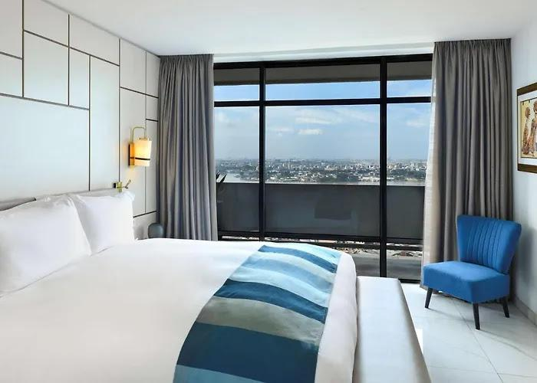
Number of special requests
Lead Time
Online booking
Average price of a room
Notes:
Based on our top 2 most accurate models, factors that influence a cancellation tend to be lead time, online booking, number of special requests and average price of the room.

Slide 33
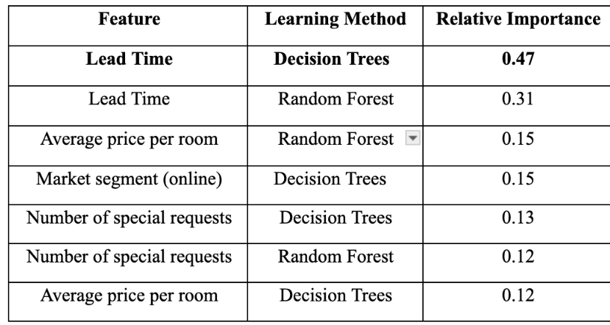
Bookings with high lead time
⇒ High probability of cancellation
Recommendation
⇒ Hotels to limit how ahead in time guests may book their rooms
Recommendation
Notes:
Given that our models reveal that lead time have the highest relative importance, we recommend that hotels limit how ahead in time guests may book their rooms as bookings with high lead time have a higher rate of cancellation.

Slide 34
2. Bookings with special requests
⇒ Low probability of cancellation
Recommendation
⇒ Hotels to offer customisable packages that allow for guests to personalise their stay
Recommendation
Notes:
Next, it was seen that bookings with special requests have a low probability of cancellation. Which is understandable as guests are able to make their stay unique through such requests. Therefore, we recommend hotels to offer customisable packages to guests. Which will accommodate special requests as well as provide a personalised stay. This way hotels would be able to retain their guests as each stay would be tailored to the preferences of the guests.

Slide 35
3. Bookings done online
⇒ High probability of cancellation
Recommendation
⇒ Hotels to provide competitive prices
While simultaneously
⇒ Hotels to limit number of online bookings
Recommendation
Notes:
Lastly, it was seen that bookings done online have a high probability of cancellation. This is probably due to the fact that guests are now able to compare prices of different hotels with a click of a button. Hence we recommend hotels to provide competitive prices while limiting the number of online bookings hotels accept. Thank you for your attention!

Slide 36
Thank You!

